Slide 1
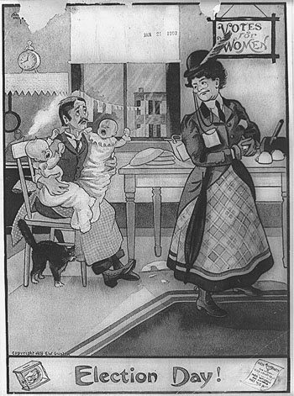
Explain what point the cartoonist is trying to make about the 19th Amendment.

