Slide 1
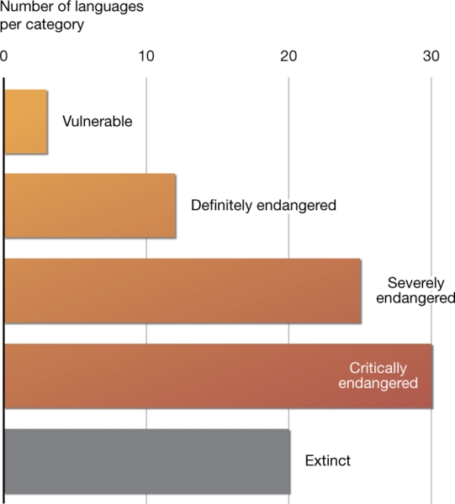
Vitality of indigenous languages of the Arctic

Slide 2
Vitality of indigenous languages of the Arctic
It is striking to note that 20 languages have become extinct since the 1800s and that ten of these extinctions have taken place after 1990 indicating an increasing rate of language extinction.
Of these extinctions, one was in Finland, one in Alaska, one in Canada, and seventeen in the Russian Federation. With this in mind, some countries are pushing to document the 30 languages classified as “critically endangered” in an attempt at revitalization.
Sources
Data used to compile the information for this analysis came from a wide variety of sources both official and academic. Each of the CAFF countries where possible provided statistical information. The Indigenous Peoples organisations (Permanent Participants to the Arctic Council) provided information and further to these sources academic publications were utilised.

Slide 3
How many languages are extinct?
How many languages are endangered?
What is the difference between a language being labeled “extinct” and “vulnerable?”
Do you think preserving a language is important? Explain your answer.

