Slide 1
Warm-up 9/10
The population density of the US is 34 people per square mile.
What countries do you think are more densely populated than the US? Why?
2. What countries do you think are less densely populated than the US? Why?
Hint: Review your notes from yesterday about population density.

Slide 2
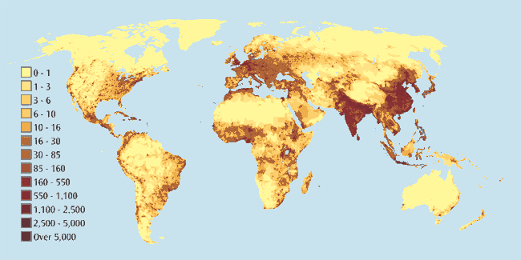
Were you correct?

