Slide 1
Treaty of Versailles
Signed June 28, 1919
Debated by Britain, France and US (“Big Three”)

Slide 2
Territorial
Military
Germany’s overseas colonies taken away
Germany had to return lands taken through treaties before WWI
Germany pays war reparations (6.6 million pounds)
Almost impossible for Germany to ever repay (finally repaid in 9/2010)
Germany’s army limited to 100,000 soldiers
Tanks, submarines and air force banned
Germany forbidden to unite with Austria
Germany was essentially forced to sign the Treaty
Economic
Political

Slide 3
Germany finally pays off WWI debt
September 30, 2010
“Germany not only celebrates 20 years since reunification this weekend, it will also pay off the last of its World War I debts, 92 years after the 1914-18 conflict ended.
These "reparations" were intended partly by the Allies, particularly France, to keep Germany weak.
But historians say the ultimate effect was the opposite, playing a key role in Adolf Hitler's rise to power and World War II.”

Slide 4
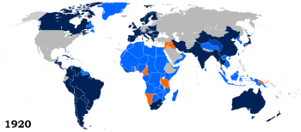
League of Nations Created
GOAL: Preventing war through
Disarmament
Collective security
Negotiations instead of war
Precursor to the United Nations
The US does not join:
Requires working with the int’l community
Could limit US sovereignty (independence in decision-making)

