Slide 1
The Need for an American Government
Origins of American Government and The Articles of Confederation

Slide 2
British Origins of American Constitutionalism
1215: The Magna Carta or “Great Charter” addressed feudal relationships between the king and the three classes of the population—barons, clergy and merchants
3 main principles of Magna Carta:
Rule of Law- everyone, even rulers, must obey the law
Certain basic rights may not be denied by the gov’t
Governments should be based on an agreement or contract between the ruler and the ruled

Slide 3
Colonial America
Colonists began to resist British control because of excessive restrictions placed upon them limited life, liberty and property
“Taxation without representation” – Colonists were being taxed by the gov’t, but had no say/vote in politics
Colonists rebelled and met at the Constitutional Congress to discuss America’s future

Slide 4
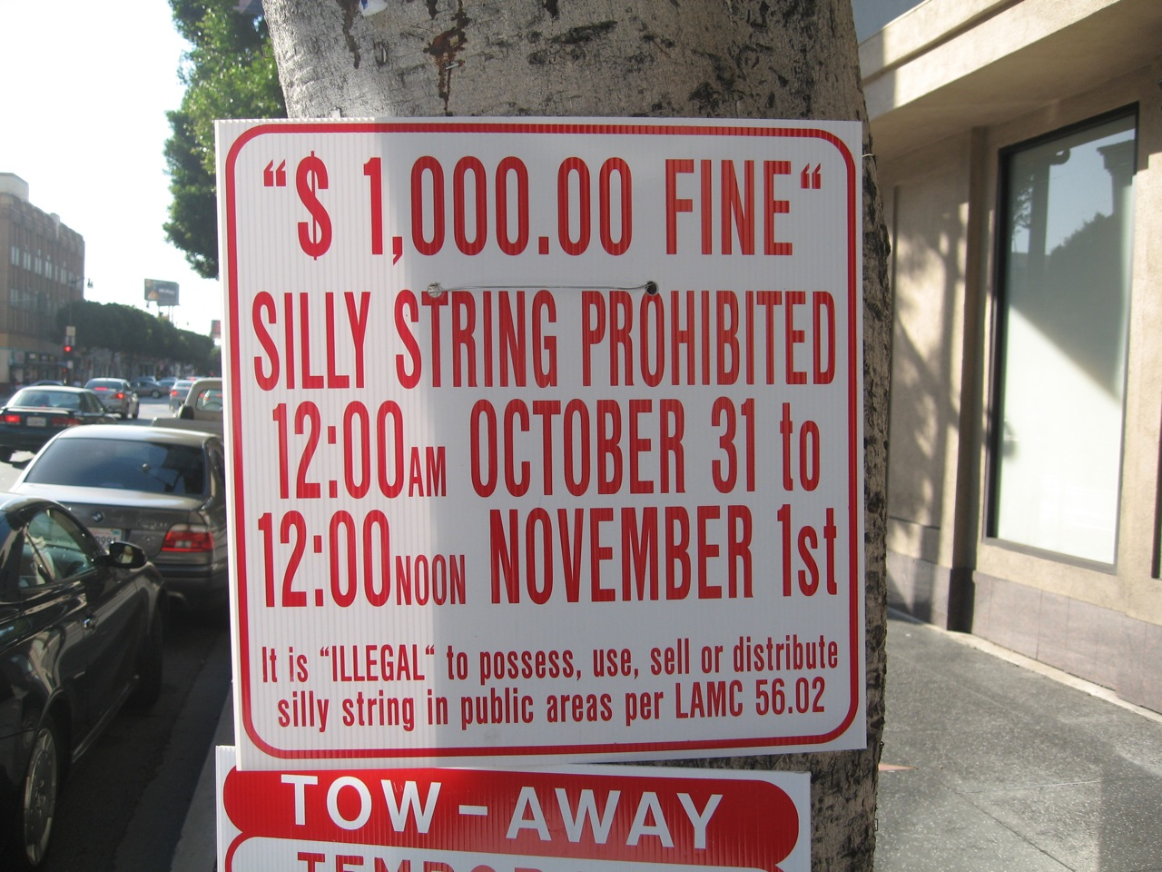
Discuss with table group.

Slide 5
The Declaration of Independence
Final step in resistance
Every state should have sovereignty (supreme power or authority)
In Britain, only the Parliament had sovereignty
Main ideas:
Rights of people are inalienable (inherent, undeniable)
When gov’t violates these rights the people are allowed to “alter or abolish it”
The king violated these rights so the colonists must act to protect them…Revolutionary War

Slide 6
State Constitutions
Came before national Constitution and included:
Higher law and natural rights
Purpose of gov’t is to preserve and protect citizens’ natural rights to life, liberty and property
Social contract
Gov’t is formed as result of an agreement among its people to create a gov’t to protect their natural rights
Popular sovereignty
Authority to govern is given to the gov’t by the people of that state

Slide 8
State Constitutions, con’t.
Representation and the right to vote
People must have a say in gov’t
Legislatures comprised of officials elected by the people
Legislative supremacy
Majority of power given to legislative branch (Senate and House)
It’s their job to protect the rights of the citizens
Checks and balances
Branches of gov’t hold different levels of power
Checks are in place to prevent abuse

Slide 9
In 1776, each state created its own gov’t
They also recognized the need for a national gov’t to manage relations and trade between states, the world
The Articles of Confederation were written in 1777 and adopted in 1781

Slide 10
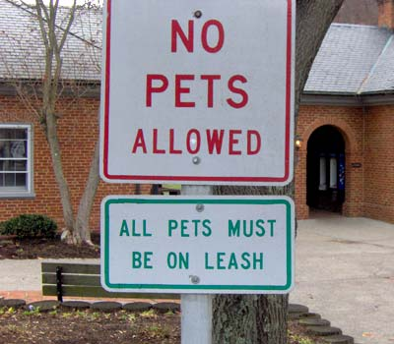

Slide 11
Problems Addressed in the Articles
Problem 1: Scared of a national gov’t that was too strong
Solution: Create a weak national gov’t
No executive or judicial branches
No authority over individuals to tax
Problem 2: Scared that some states would be more powerful than others in a national setting
Some states have larger populations
Solution: Give each state one vote

Slide 12
Weaknesses of the Articles
No money and no power to get money
No power over the state governments and their citizens
Unenforceable trade agreements
Unfair competition among states
Threats to citizens’ rights of property

Slide 13
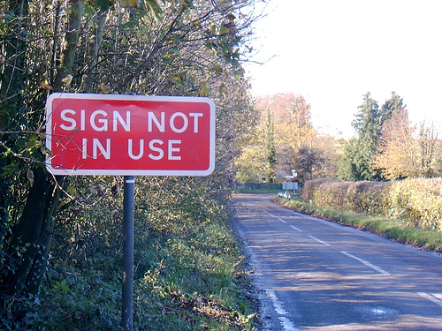

Slide 14
Shay’s Rebellion
1786- Daniel Shay and other Massachusetts farmers rebelled as a result of debt and taxes
Sent to prison if couldn’t pay debt
Attempted to steal weapons from arsenal
Main point: The difficulty in raising revenue and regulating trade convinced many that a stronger national gov’t was necessary

Slide 15
Conclusion
Founding Fathers wanted to limit federal power because of their experience with the British king
Articles created a national gov’t so weak that it caused separation between states
How do you balance states’ rights with federal power?

