Slide 1
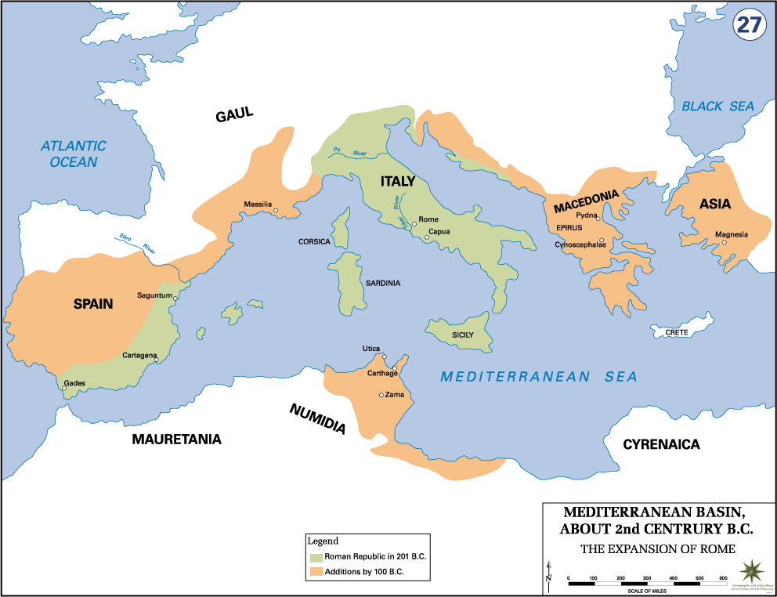
Warm-up: What do you think allowed the Roman Empire to grow so large in 100 years?

