Slide 1
Population

Slide 2
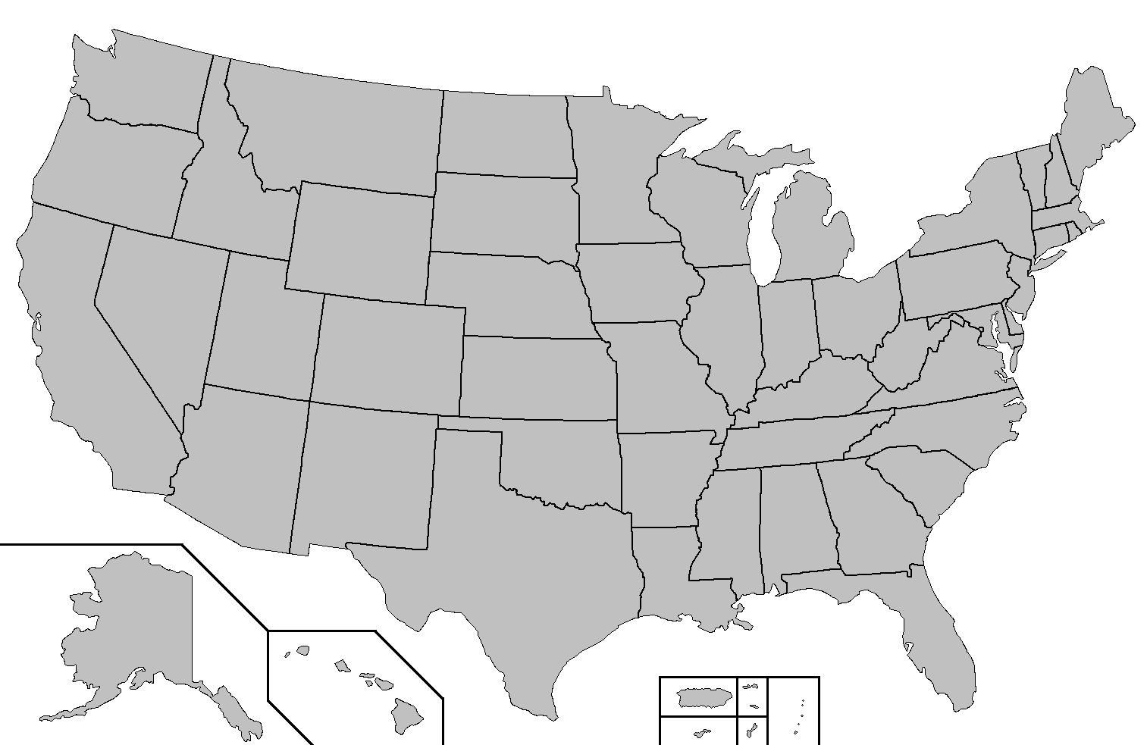
Population Distribution
Population distribution explains where people live.
Why do some people prefer to live in region A compared to region B?
What factors are involved in people migrating (moving) from one place to another?
In your notes:
1. Copy the definition of population distribution.
2. Write down five migration factors.
B
A

Slide 3
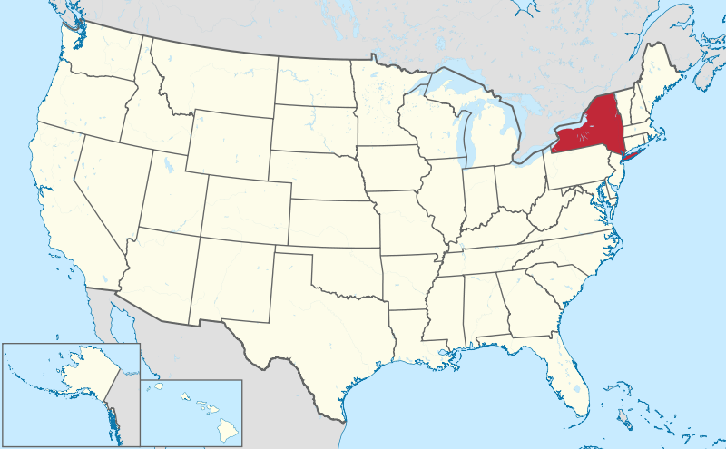
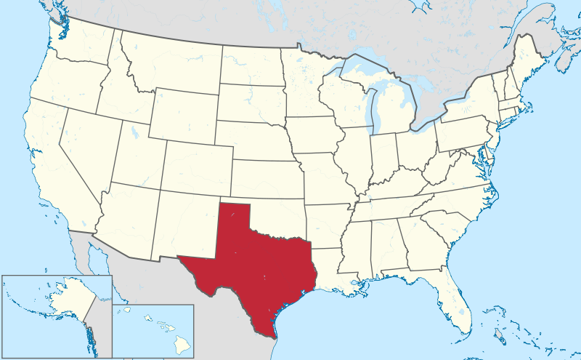
Pretend that these two states have the same total population: 30 million
New York
Texas
Which state is more densely populated? How do you know?

Slide 4
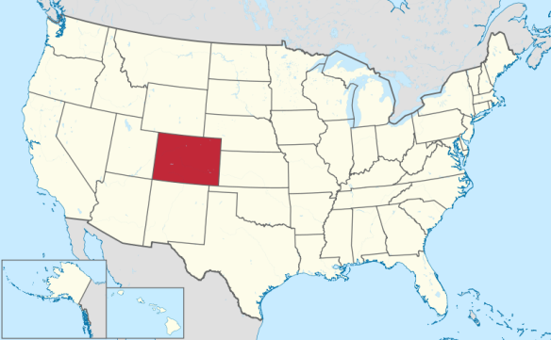
Population Density
Population density describes the number of individuals occupying an area in relation to the size of that area
Population density = number of people ÷ the area they occupy
Go to the US Census Population Finder and find Colorado.
CO Population: _________
CO Area: 104,000 sq. miles
CO population density: _______
In your notes:
1. Copy the definition of population density and equation.
2. Write down the data for CO.

Slide 5
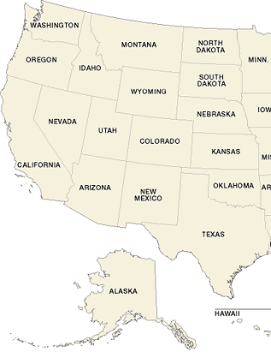
Your Turn
Step 1: Form a hypothesis about what areas of the western US will be the most populated. Use cardinal directions (N, S, E, W) and state names for your hypothesis.
Remember, you need to include a what and a why.
Ex: The states bordering the Pacific Ocean will have a high/low population density because ________.

Slide 6
Your Turn
Step 2: Map your hypothesis.
Create a scale using four shades of the same color. The lightest shade should be the least densely populated. The darker shade should be the most densely populated.
Shade your hypothesis on your map.

Slide 7
Your Turn
States I predicated would have the highest pop. density | Actual pop. density | States I predicated would have the lowest pop. density | Actual pop. density
1. |  | 1.
2. |  | 2.
3. |  | 3.
Step 3: Test your hypothesis (states).
Copy the table to the right into your notes and fill it out using the map you made and the actual data you were given.
Where was your hypothesis accurate?
Where was your hypothesis inaccurate?

Slide 8
Your Turn
Step 3: Test your hypothesis (regions).
Compare your map to the regions on this population density map. What regions did you predict correctly?
Incorrectly?

Slide 9
Your Turn
Step 4: Explain the data you collected.
What explanations can you offer for why California is so densely populated?
What explanations can you offer for why the northern states on the map are the least densely populated?

