Slide 1
The Lincoln Memorial Washington, DC

Slide 2
Mt. Rushmore
South Dakota

Slide 3
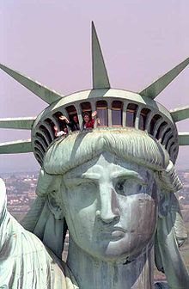
Statue of Liberty Ellis Island, NY

Slide 4
Washington Monument
Washington, DC

