Slide 1
Warm-up 9/18
How did humans first arrive in North America 20,000 years ago?

Slide 2
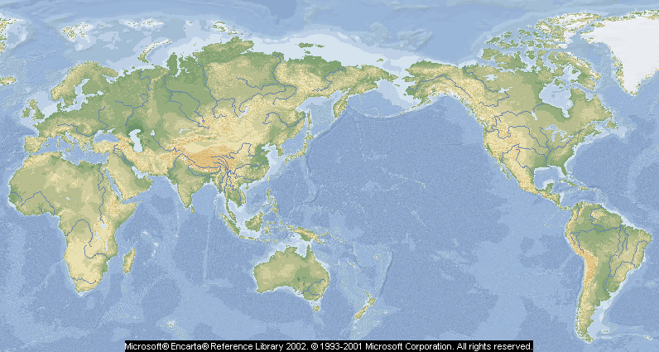
Migrations of Homo sapiens
Siberia
40,000 years ago
Europe
40,000 years ago
North America
12,000-30,000
years ago
Oceania
1600 B.C.E.-500 C.E.
Southwest Asia
100,000 years ago
Human Origins
200,000-250,000
years ago
Australia
as many as 60,000
years ago
Chile
12,000-13 ,000
years ago
Possible coastal routes of human migration
For what reasons were these people moving?
Possible landward routes of human migration
Migrations in Oceania

Slide 3
STAND UP!
If you were born in Collbran, sit down
If you were born in Grand Junction, sit down
If you were born in Colorado, sit down
If you were born in the US, sit down
If you were not born in Colorado, why did your parents move here?
Where do your grandparents live? Where did they used to live? How and why did they arrive at their current location?

Slide 4
Break up into 2 groups
Group A
A group of space explorers that has gone to Mars and established a small colony there.
Group B
A group that has built an underwater colony in the Indian Ocean
As a group, determine the factors that would have to be present in order to move from your area to the other.
If you, personally, were forced to choose between being in one of these groups, which would you pick and why? (Answer with more than one sounding cooler than the other!)

