Slide 1
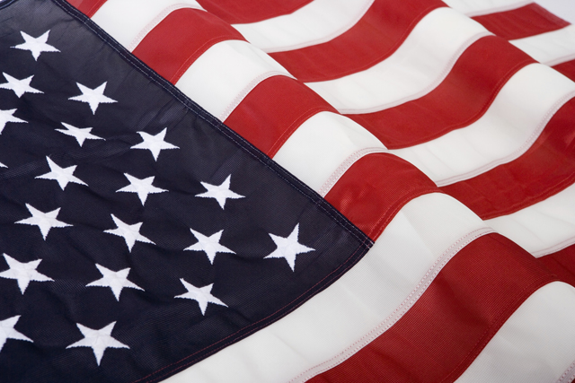
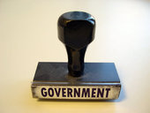
Notes:
http://dictionary.reference.com/browse/government
gov·ern·ment
/ˈgʌvərnmənt, ‐ərmənt/ Show Spelled[guhv-ern-muhnt, ‐er-muhnt] Show IPA
–noun 1. the political direction and control exercised over the actions of the members, citizens, or inhabitants of communities, societies, and states; direction of the affairs of a state, community, etc.; political administration: Government is necessary to the existence of civilized society.
2. the form or system of rule by which a state, community, etc., is governed: monarchical government; episcopal government.
3. the governing body of persons in a state, community, etc.; administration.
4. a branch or service of the supreme authority of a state or nation, taken as representing the whole: a dam built by the government.
5. (in some parliamentary systems, as that of the United Kingdom) a. the particular group of persons forming the cabinet at any given time: The Prime Minister has formed a new government.
b. the parliament along with the cabinet: The government has fallen.
6. direction; control; management; rule: the government of one's conduct.
7. a district governed; province.
8. political science.
9. Grammar . the extablished usage that requires that one word in a sentence should cause another to be of a particular form: the government of the verb by its subject.

Slide 2
What does the US Government do for you?
Brainstorm and write as many services and products that the government provides for you.
After 10 minutes, share to create a chart of what we know the government does for us.

Slide 3
Share
Roads maintained
Public education

Slide 4


Preamble: compare what you brainstormed to these Following concepts:
We the people of the United States of America, in Order to form a more perfect Union, establish Justice, insure domestic Tranquility, provide for the common defense, promote the general Welfare, and secure the Blessings of Liberty to ourselves and our Posterity, do ordain and establish this Constitution for the United States of America.

Slide 5
Preamble
Categorize the government services or product below:
Form a more Perfect Union | Establish Justice | Insure Domestic Tranquility | Common Defense | General Welfare | Secure the Blessings of Liberty to our posterity

Slide 6
“We the People of the United States”
A government for the people by the people.
Power comes from the people rather than the states or national government.

Slide 7
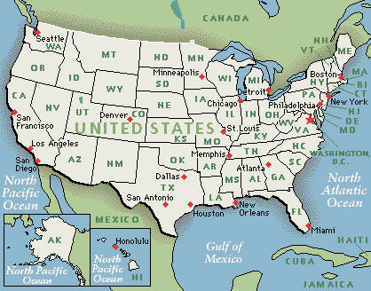
“…in Order to form a more perfect Union…”
Union: a group of states or nations united into one political body, as that of the American colonies at the time of the Revolution
http://dictionary.reference.com/browse/union
Colonists and our founding fathers were unsatisfied with the gov’t that had ruled them from England
Wanted to create a new gov’t that was founded on basic rights of the people
Can you think of instances when we were not a perfect union?
How have we overcome struggles and remained united?
What does overcoming struggles as a nation mean to you?
Is it still important to work on being a more perfect nation today?
Name other countries or states that are “UNITED”?

Slide 8
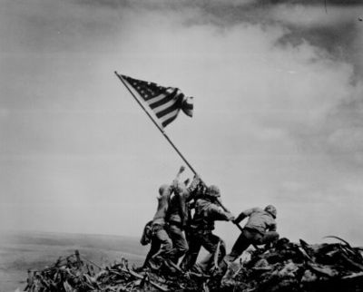
“…establish justice…”
Protection from the violation of your personal rights
“…America-strong, outspoken, intense in their convictions, sometimes wrong-headed but always generous and brave, with a passion for justice no nation has ever matched.”
Johnson, Paul. History of the American People. New York: HarperCollins: 1997.
How would you define America’s passion for justice?
Can you think of historical moments when we, as Americans, wanted justice?
Have you personally dealt with the American Judicial System?
Can our need for justice be too extreme? If so, when?

Slide 9
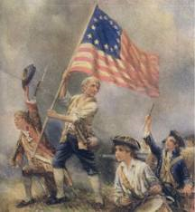
“…ensure domestic tranquility…”
Ensure = guarantee/maintain
Domestic = within the US
Tranquility = peace
“One of the main goals of the Convention, then, was to ensure the federal government had powers to squash rebellion and to smooth tensions between states.”
http://www.usconstitution.net/const.html
Can you think of other moments in history when the US Government has “squashed rebellion?”
Notes:
http://www.usconstitution.net/const.html
One of the concerns of the Framers was that the government prior to that under the Constitution was unable, by force or persuasion, to quell rebellion or quarrels amongst the states. The government watched in horror as Shay's Rebellion transpired just before the Convention, and some states had very nearly gone to war with each other over territory (such as between Pennsylvania and Connecticut over Wilkes-Barre). One of the main goals of the Convention, then, was to ensure the federal government had powers to squash rebellion and to smooth tensions between states.

Slide 10
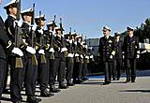
“…provide for the common defense…”
A common and united defense
Protection from foreign threats
How many “wars” can you name that the United States has been involved in?
http://www.mapsofwar.com/ind/american-wars.html
Notes:
Colonial Wars
War of Independence
Mexican-American War
American Civil War (1861-1865)
Indian Wars (1865-1870)
Spanish-American War (1898)
Banana Wars
World War I
World War II
Cold War
Korean War
Vietnam War
Gulf War
War on Terrorism
Afghanistan
Phillippines
Iraq
We occupied many other place, overthough dictatorships an

Slide 11
“ …promote the general welfare…”
As meant in Constitution
Another meaning today…
welfare n. 1. health, happiness, or prosperity; well-being. [<ME wel faren, to fare well]
Contribute to the growth and development of the well-being of the people
Welfare in today's context also means organized efforts on the part of public or private organizations to benefit the poor, or simply public assistance. This is not the meaning of the word as used in the Constitution.
How do you think our government works to promote the general welfare?
Notes:
http://www.usconstitution.net/glossary.html

Slide 12

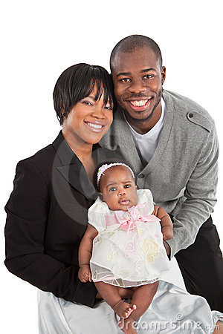

“…and secure the Blessings of Liberty to ourselves and our Posterity…”
The Constitution is for us and for the generations to come
Founding Fathers wanted to create a gov’t that was stable and organized enough to last for a long time
What are you doing to help our government preserve posterity?

Slide 13
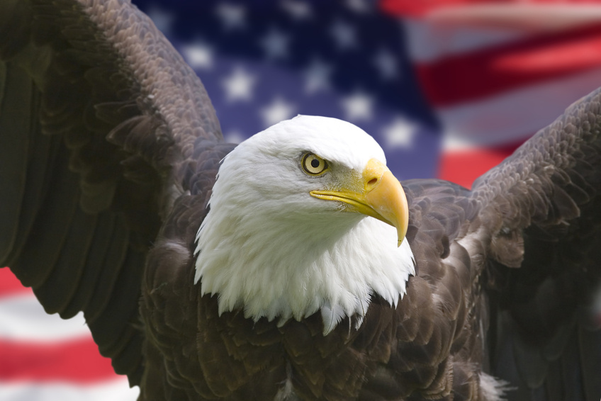
“…do ordain and establish this Constitution for the United States of America…”
Ordain = to make legal
Establish = bring into existence

Slide 14
What power does the Preamble have?
NONE!
It is not a source of federal power or individual rights
It is the articles and amendments that follow in the Constitution that provide these powers
Think of the Preamble as an introduction to the Constitution, like the first paragraph of an essay you write. It catches the reader’s attention and outlines what will follow.
Notes:
The character of a nation is sometimes best refined by its fieriest trials. How it has revealed in the story of the struggles to establish and preserve unity, justice, liberty, and the common good. It is the story of ordinary people joining their efforts to achieve the extraordinary. It is the story of a people…We, the people….
Author unknown

