Slide 1
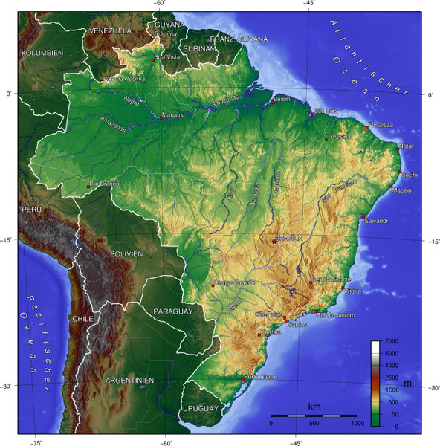

Slide 2
How Cartographers Look at the World
Use the corresponding note worksheet to take notes on this presentation.

Slide 3
From 2-D to 3-D
1. If you wanted to turn a sphere (3D) into a rectangle (2D), what challenges would you come across?
Click on the link below to answer questions 2- on your note worksheet.
http://www.classzone.com/books/earth_science/terc/content/investigations/es0301/es0301page01.cfm

Slide 4
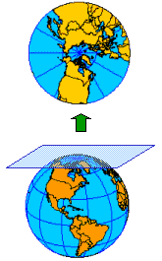
Planar Projection
What area of this map is the most accurate?
What area is the least accurate?

Slide 5
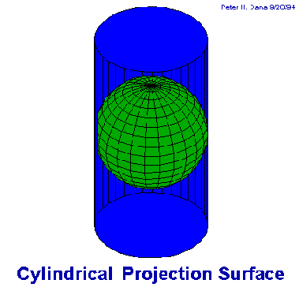
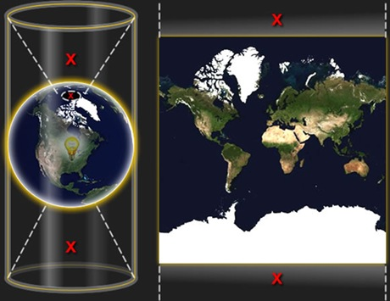
Cylindrical Projection
What area of this map is the most accurate?
What parts of this projection are distorted?

Slide 6
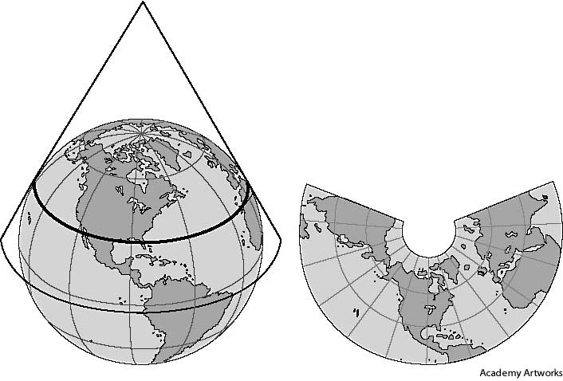
Conic Projection
When might you use this map projection?

Slide 7
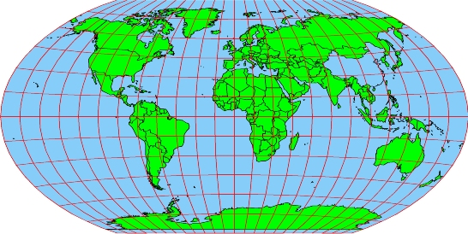
Winkel Tripel Projection
Most common projection
Balances size and shape well
Polar areas are only slightly distorted

Slide 8
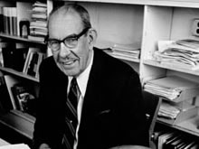
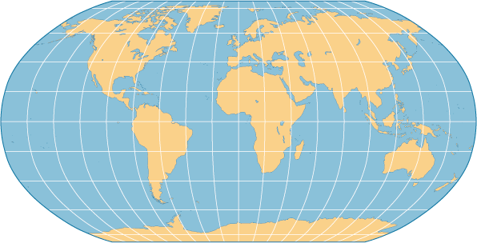
Robinson Projection
Sizes and shapes of east and
west regions are accurate
Polar areas are flattened

Slide 9
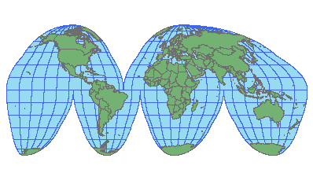
Goode’s Interrupted Equal-Area
Shows sizes and shapes correctly
Distorts distance

Slide 10
Mercator Projection
Accurate at the Equator, but distorts size and distance
Shows true direction and landmass shape
Good for sea navigation

Slide 11
What do you think is the best map projection for each of the following tasks? Explain your answer.
Sailing a ship from the southern tip of South America to Australia.
Driving from San Francisco, CA to Washington, DC.
Flying from the North Pole to the South Pole.

